Slide 1
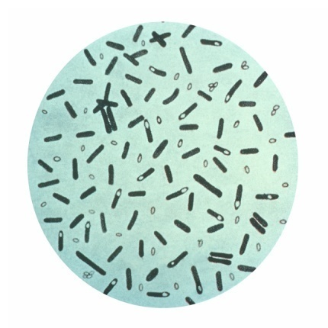
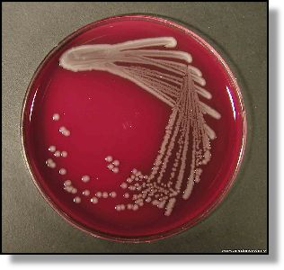
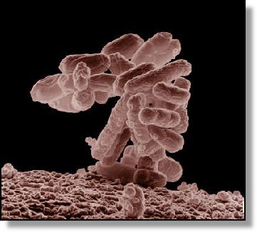


TOXICOLOGY ON FISHERIES PROCESSING– 3 (2 – 1)
DISEASES ARE CAUSED BY MICROORGANISMS
EKO SUSANTO
Study Program of Fisheries Processing Technology
Diponegoro University
Email : eko_thp@undip.ac.id
EKO SUSANTO – DIPONEGORO UNIVERSITY

Slide 2
References:
Peck, M.W., 2010. Clostridium botulinum. Edited by: Juneja, K.V., and Sofos, K.N. Pathogens and Toxin in Food: challenges and intervention. ASM Press. Washinton DC.
Juneja, K.V., Novak, J.S., and Labbe, R.J, 2010. Clostridium perfringens. Edited by: Juneja, K.V., and Sofos, K.N. Pathogens and Toxin in Food: challenges and intervention. ASM Press. Washinton DC.
Beauchamp, C.S. and Sofos, J.N. 2010. Diarahegenic Eschericia coli. Edited by: Juneja, K.V., and Sofos, K.N. Pathogens and Toxin in Food: challenges and intervention. ASM Press. Washinton DC.
Seo, K.S. Bohach, G.H., 2010. Staphylococal Food Poisoning. Edited by: Juneja, K.V., and Sofos, K.N. Pathogens and Toxin in Food: challenges and intervention. ASM Press. Washinton DC.
Wright, A.C. and Sceneider, K.R. 2010. Pathogenic vibrios in seafood. Edited by: Juneja, K.V., and Sofos, K.N. Pathogens and Toxin in Food: challenges and intervention. ASM Press. Washinton DC.
EKO SUSANTO – DIPONEGORO UNIVERSITY (eko_thp@undip.ac.id)

Slide 3
REFERENCES: Continue
Amastrong, G.D. 2008. Pathogenic Mechanisms of the Enterohemorrhagic Escherichia coli—Some New Insights. Edited by: Wilson, C.L. Microbial Food Contamination 2nd ed. CRC Press. Boca Raton.
Nilsson, L. and Gram, L. . 2002. Improving the control of pathogens in fish products. Edited by: Bremmer, A.H. Safety and quality issues in fish processing. CRC Press. Boca Raton.
WHO-FAO. 2005. Microbiological risk assessment series: Risk assessment of Vibrio vulnificus in raw oysters interpretative summary and technical report. WHO-FAO UN.
Garbutt, J. 1997. Essentials of food microbiology. Arnold. London.
Pelczar, M.J. & Chan, E.C.S. 1976. Dasar-dasar mikrobiologi. Diterjemhakan: Hadioetomo et al., 1988. UI press.
Huss, H.H. 1994. Assurance of seafood quality. FAO fisheries technical paper.
EKO SUSANTO – DIPONEGORO UNIVERSITY (eko_thp@undip.ac.id)

Slide 4
LECTURE rules
The lecture will be taken place during 4 meetings
10 minutes after lecturer starting lecture. Students are prohibited to get in class.
If the lecturer is late 10 minutes after the start of lecture time without confirmation to students, the students are permitted to leaving class.
Final score consist of 35 % tasks and 65 % of final examination
The students have to attend lecture 75 % minimally.
The lecture consist of class lecture and self study.
The students are permit to get out class during lecture if they don’t want to joining lecture.
EKO SUSANTO – DIPONEGORO UNIVERSITY (eko_thp@undip.ac.id)
Eko Susanto – Diponegoro University

Slide 5
INTRODUCTION
Food-borne diseases are of major concern to consumers, producers and authorities alike.
Despite an increased awareness, the number of cases and outbreaks does not appear to be decreasing.
Many foods are implicated in food-borne disease outbreaks.
Seafoods rank third on the list of products which have caused food-borne disease.
Seafoodborne disease may be caused by a variety of agents, including aquatic toxins, biogenic amines, bacteria, virus and parasites.
Bacteria are mostly found in low numbers in live fish with the exclude of marine vibrios.
Marine vibrios, such as V. parahaemolyticus and V. vulnificus, may be found in high numbers in shellfish and in shellfish-eating fish from tropical waters and during the summer months in temperate zones
EKO SUSANTO – DIPONEGORO UNIVERSITY (eko_thp@undip.ac.id)

Slide 6
3rd meeting

Slide 7
Vibrio toxin

Slide 8
Characteristic of microorganism
Vibrios are gram-negative.
aquatic bacteria
several species are also pathogens of fish and shellfish.
All species appear as curve-shaped rods with one or two single-polar flagella in standard culture.
Metabolically they are moderate halophiles and facultative anaerobes that use glucose as a sole carbon source.

Slide 9
Characteristic of microorganism
Most vibrio are marine origin & they require Na⁺ for growth.
The pathogenic species are mostly mesophilic ➔ ubiquitous in tropical waters & highes in temperate temp during last summer / early fall.
Disease vibrio sp → gastroenteritic symptoms varying mild diarrhea → classical cholerae
Exception → V. vulnificus which characterized by septicaemias

Slide 10
TYPE OF ILLNESS AND
CHARACTERISTICS OF THE ORGANISMS

Slide 11
Vibrio cholerae
V. cholerae is gram negative-bacteria
V. cholerae is transmitted primarily through contaminated drinking water.
more recent epidemics in south ameria clearly implicate raw or undercooked fish and shellfish.
V. Cholerae distribution include freshwater ponds and river basin.

Slide 12
Sympthom of cholerae
causes fluid and electrolyte loss due to diarrhea: muscle cramps, dizziness, and low blood pressure.
The incubation period may vary from a few hours to several days and is dependent on both the dose of organisms ingested and the pH level of the stomach.
cholera stools are characterized by a clouded, milky white appearance termed.
potentially dangerous aspect of cholera is a rise in the acidity of body fluids that can lead to pulmonary edema in severe cases of disease

Slide 13
Survival of V. Cholerae (Huss, 1994)
Food | Survival times (days)
Fish stored at 3-8ºC | 14-25
Ice stored at -20ºC | 8
Shrimp, frozen | 180
Vegetables in a moist chamber, 20ºC | 10
Carrots | 10
Cauliflower | 20
River water | 210

Slide 14
Typical symptoms associated with different Vibrio species
Vibrio species (type) | Symptoms
 | Gastroenteritis | Severe diarrhea | Septicemia | Wounds
V. cholerae (epidemic) | Less Common | common | No | Rare
V. cholerae (nonepidemic) | Common | No | Rare | Rare
V. parahaemolyticus | Common | No | Rare | Less common
V. vulnifi cus | Less common | No | Common | Common

Slide 15
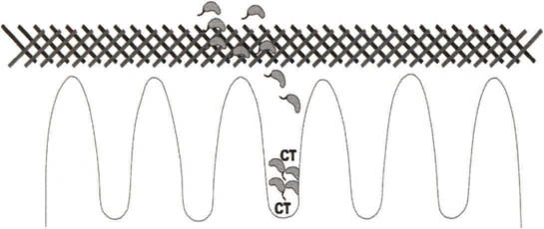
Model for opposite regulation of motility and colonization. Vibrio cholerae cells are
hypothesized to be in two distinct populations within the intestine. A motile population within the
lumen swims through the mucus layer (hatched area) but lacks expression of colonization factors or
toxin. Cells that migrate to the epithelial layer stop swimming, represented by lack of flagella, and
produce cholera toxin (CT) and colonization factors such as the toxin-coregulated pilus. Signals such
as bile within the lumen may contribute to downregulation of pilus and toxin production

Slide 16
Vibrio parahaemolyticus
V. parahaemolyticus was first described as the causative agent of outbreaks of gastrointestinal illness in Japan.
Occasional dysentery, wound infections, and septicemia are also caused by V. parahaemolyticus, but fatalities are rare
Diarrhea may result from toxin-mediated induction of Ca²⁺ activated chloride channels, leading to fluid accumulation.

Slide 17
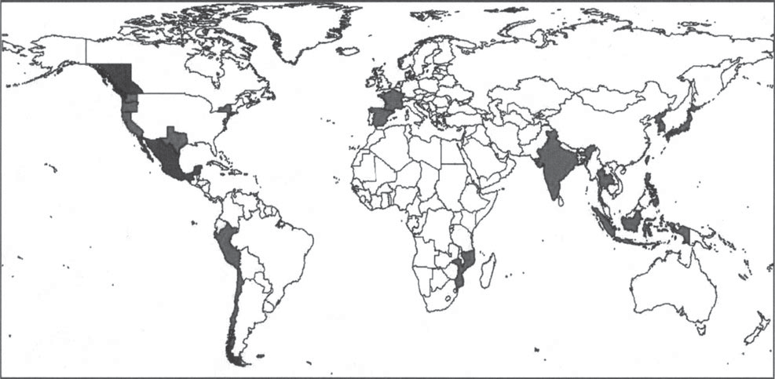
Global distribution of “pandemic” V. parahaemolyticus disease

Slide 18
Vibrio vulnificus
V. vulnificus typical symptoms are dramatically different from those of other pathogenic vibrios.
Disease can result either as a consequence of seafood consumption or from exposure of wounds to seawater or through the handling of seafood.
Illnesses caused by V. vulnificus are rarely seen in healthy adults or children.
This species is very much an opportunistic pathogen, and persons who are at risk for this disease generally exhibit some type of underlying condition that includes alcoholic cirrhosis, hepatitis C, diabetes, hemochromatosis (iron overload), and immune system dysfunction.
Vibrio species can be pathogens of fish, mollusks, and crustaceans, they commonly appear to coexist without damage to the host.

Slide 19
symptoms
Cause gastrointestinal illness : mild diarrhea and vomiting.
The most common cause of serious wound infections associated with Vibrio species, and these infections may result from exposure of breached skin surface to seawater or contaminated seafood handling.

Slide 20
Reported cases of V. vulnificus in Florida from 1990 to 2005.

Slide 21
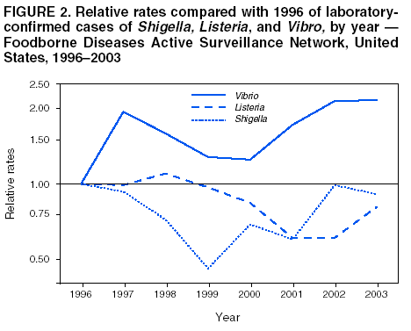
MMWR
Notes:
This graph shows the 2003 relative incidence rates compared with 1996 confirmed cases of Shigella, Listeria and Vibrio in the United States. Overall there has been a decrease in Listeria and Shigella, while there were roughly twice as many cases of Vibrio in 2003 than in 1996. Data from MMWR April 30, 2004 / 53(16)338-343.

Slide 22
EXTRINSIC FACTORS:
ROLE IN SURVIVAL AND GROWTH
IN FOOD PRODUCTS

Slide 23
Extrinsic factors
Temperature (optimum 30-37ºC).
Vibrios are fairly tolerant of high pH but will not grow below pH 6.
Salinity, V. parahaemolyticus and V. vulnifi cus are both moderate halophiles and will not grow below 0.1% NaCl

Slide 24
FOOD PROCESSING AND RECENT ADVANCES
IN BIOLOGICAL, CHEMICAL, AND
PHYSICAL INTERVENTIONS

Slide 25
depuration
The process involves the removal of potential pathogens by placement of shellfish in sanitized seawater that is usually treated either by ozonation by UV light during recirculation into wet storage tanks.
the depuration process does not effectively remove Vibrio species from shellfish.

Slide 26
Refrigeration
warm and cold temperature processing have been used in controlling and killing pathogenic Vibrio species in molluscan shellstock.
Bacterial levels decline somewhat with refrigeration, but vibrios are not eliminated in oysters, even with an extended exposure of 10 to 15 days.

Slide 27
Ultra-Low Temperature Treatment
ultra-low temperature treatment (<-70ºC) has been shown to effectively reduce vibrios when it was followed by extended frozen storage at -20ºC for 1 to 2 weeks, depending on the process.
Ultra-low freezing can be achieved by immersion of shellstock in liquid nitrogen or CO2, and liquid nitrogen treatment was recently validated as an oyster PHP for reduction of V. vulnifi cus

Slide 28
high-pressure processing
(HPP)
Heating is also an effective treatment for elimination of Vibrio species.
All Vibrio species die rapidly at temperatures exceeding 55ºC.
immersion in hot water (50ºC for 5 to 10 minutes) combined with frozen storage and achieves the desired reduction within 2 weeks.
Traditional pasteurization is also done at 75C for 8 min.

Slide 29
Irradiation
Oysters appear tolerant to irradiation processing at levels of a 2.5-kGy absorbed dose, as normal shelf-life is maintained with no increase in mortality compared with untreated control oysters.
higher levels of irradiation increased mortality and resulted in a yellow exudate and an unpalatable product.
V. Parahaemolyticus cultures were less sensitive to irradiation compared to V. Vulnificus.

Slide 30
Dissease control
Water drinking
  Drinking water should be disinfected
  Tablets releasing chlorine or iodine.
  Water for drinking should be boiled before used
  Water QC should be strenghthened by intensifying the surveillance & control residual chlorine.

Slide 31
Dissease control
Sanitation
  QC in sewage treatment plants should be strenghthened.
  Large scale of chemical treatment of waste water is very rarely justified.
  Health educatin should emphsize the safe disposal of human faecess.
Vibrios are easily destroyed by heat
Proper refrigeration is essential in controling growth.

Slide 32
Salmonella sp

Slide 33
Characteristics of salmonella sp
Member of family Enterobacteriaceae .
Occuring in the gut of man & animals in environment polluted with human or animals excreta.
Salmonella can multiply & survive in the estuarine & freshwater envi
Gram negative rod (S. serovar).
Typhoid fever, caused by the exclusively human pathogens S. typhi and S. paratyphi,

Slide 34
POSSIBLE PATHWAYS THAT CAN LEAD TO THE CONTAMINATION OF FOODS WITH SALMONELLA

Slide 35
Cross infection
Wild animal reservoir including birds, insect, rodent
Grazing land & streams
Animal Feed
Fish meal
Slurry
Livestock ncluding poultry
Cross infection
Rendering plant
Abattoir or poultry processor
Food manufacture
Cross infection
RETAILER
Domestic pets
FOOD PRODUCT
Imported food product
Infected consumer
Other raw material
Human carrier
Sewage

Slide 36
symptoms
Non-bloody diarhoea
Abdominal pain
Fever, nausea, headache
vomiting after 12-36 hours ingestion.
Dehydration → collapse & death.

Slide 37
Mechanism of Salmonella Infection

Slide 38
Gastroenteritis is caused by salmonella
gastroenteritis are usually due to contamination of food with animal rather than human waste.
Undercooked meat, seafood, and eggs are common causes of salmonellosis.
Disease onset is approximately 8-48 hours after ingestion, and is characterized by nausea and vomiting; diarrhea, abdominal pain, and fever often follow.

Slide 39
MORTALITY
The disease does not cause death in healthy adults.
Mortality is sifnificant in the young, elderly, & the immunocompromised.
Infective dose: 10⁶ – 10⁹ cells. Variation dose is caused by:
  Host susceptibility
  Virulence of Salmonella serovar
  The type of food in which MO ingested.

Slide 40
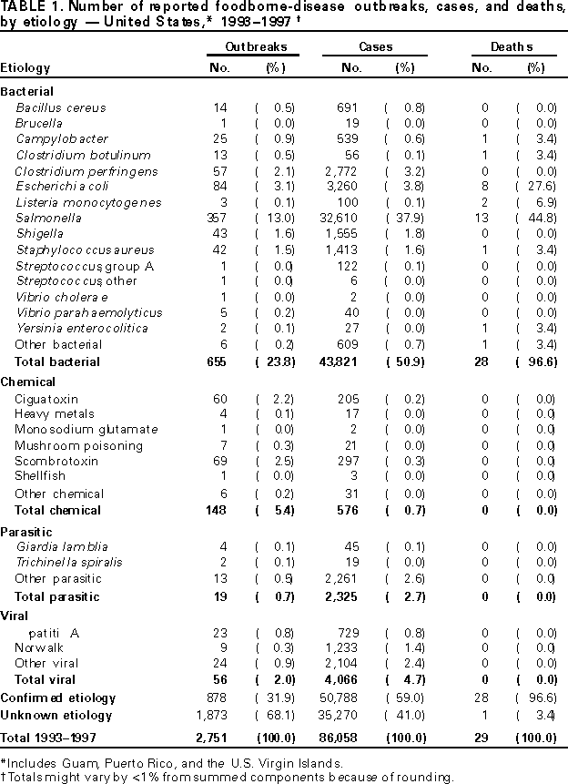
Foodborne disease outbreaks, cases and deaths
1993-1997
Salmonella had the highest number
Notes:
This table shows the number of reported food-borne outbreaks, cases and deaths from 1993-1997 in the United States. Of the bacterial agents, Salmonella cases had the highest number of outbreaks, cases and deaths. It is important to remember that these are only reported cases. Norwalk is thought to account for the most human cases of food-borne illness in the U.S., but many cases go unreported.CDC MMWR Surveillance for FoodBorne Disease Outbreaks, US 1993-1997 report March 17, 2000 http://www.cdc.gov/mmwr/preview/mmwrhtml/ss4901a1.htm#top

Slide 41
PREVENTION

Slide 42
RAW MATERIAL PRODUCTION
Use pathogen-free animal feed.
Protect water from contamination.
Dispose of animal waste hygienically.
Transport fish under hygienic condition.

Slide 43
manufacturer
Refrigerate RM below 5ºC.
Use pasteurization for fish processing
Carefully monitor heat processes.
Physically separate RM handling & product handling.
Test RM & final products.
observation personal hygiene.
use low level iradiation.
Give the consumer lear instruction for thawing frozen fish

Slide 44
consumer
Ensure frozen fish is correctly thawed before cooking.
Refrigate food at or below 5ºC.
Prevent pest contact with food / food preparation envi.
Store food above raw food in fefrigerator to prevent cross contamination.
Carefully follow personal hygiene.
Use potable water for food preparation & production
Cleanse shellfish harveted from polluted water.

Slide 45
Thank you for attention

